Slide 1
MD5

Slide 2
MD-5 takes a message of length 512 bits blocks, and produces a message digest of size 128 bits. The input is divided into blocks of size 512 bits each.
MD5 is still the most commonly used message digest for non-cryptographic functions, such as used as a checksum to verify data integrity, compressing large files into smaller ones securely, etc.

Slide 3
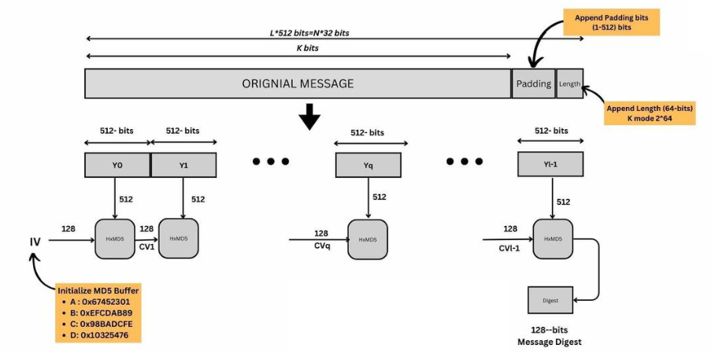
MD5 Overview
Notes:
16 * 32=512

Slide 4
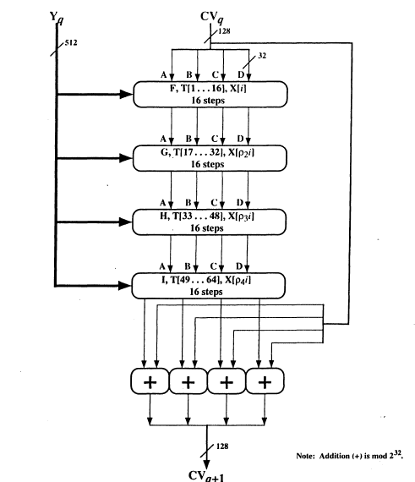
Hash Algorithm Design – MD5

Slide 5
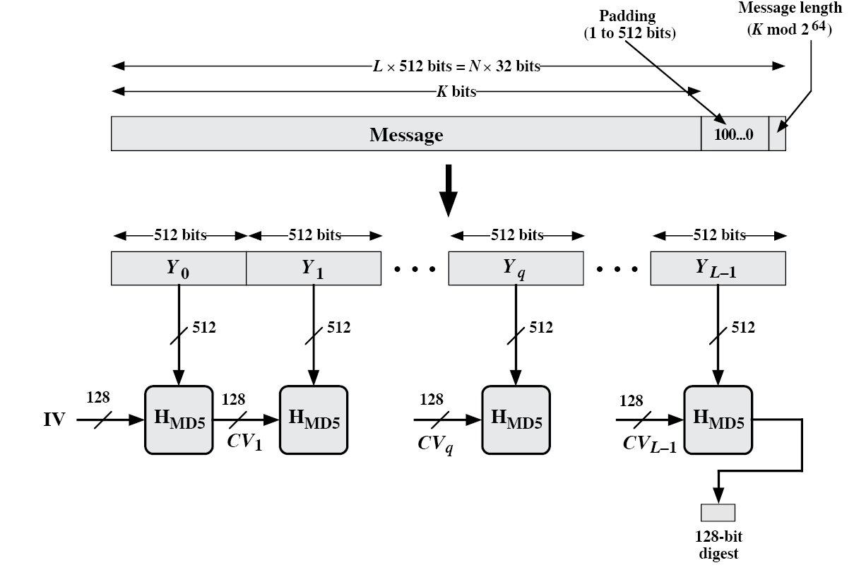
Hash Algorithm Design – MD5
16 steps
X[k] = M [q*16+k] (32 bit)
Constructed from sine function

Slide 6
Step 1: Padding
The first step in MD5 is to add padding bits to the original message.
The aim of this step is to make the length of the original message equal to a value, which is 64 bits less than exact multiple of 512.
For example, if the length of the original message is 1000 bits, we add a padding of 472 bits to make the length of the message 1472 bits. This is because, if we add 64 to 1472, we get 1536, which is a multiple of 512 (because 1536 = 512 * 3).
Thus, after padding, the original message will have a length of 448 bits (64 bits less than 512), 960 bits (64 bits less than 1024), 1472 bits (64 bits less than 1536), etc.
The padding consists of a single 1 bit, followed by as many 0 bits, as required.
Note that padding is always added, even if the message length is already 64 bits less than a multiple of 512. Thus, if the message were already of a length of say 448 bits, we will add a padding of 512 bits to make its length 960 bits.

Slide 7
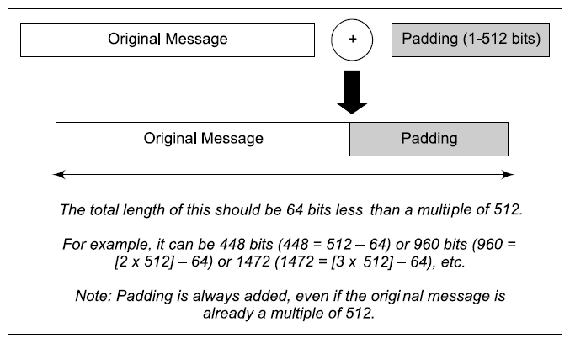

Slide 8
Step 2: Append Length
After padding bits are added, the next step is to calculate the original length of the message, and add it to the end of the message, after padding.
The length of the message is calculated, excluding the padding bits (i.e. it is the length before the padding bits were added).
This length of the original message is now expressed as a 64-bit value, and these 64 bits are appended to the end of the original message + padding.
Note that if the length of the message exceeds 2^64 bits, we use only the low-order 64 bits of the length. That is, in effect, we calculate the length mod 2^64 in that case.

Slide 9
Step 1 and 2: Example
Consider the plain text “abc”
In 8 bit ASCII , 01100001 01100010 01100011
Append padding bits
M+P+64= 0 mod 512
P=(-64-24) mod 512
=424 mod 512
Append length bits
24-> 00011000
512 bit block of “abc”
01100001 01100010 01100011 1000….00 000000…11000
Notes:
81,62 and63

Slide 10
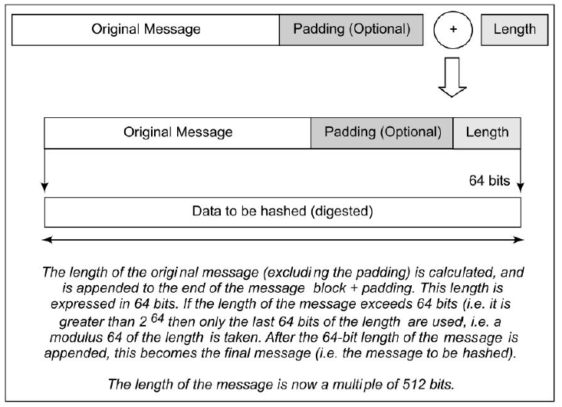

Slide 11
Step 3: Divide the Input into 512-bit Blocks
The input message is now divided into blocks, each of length 512 bits. These blocks become the input to the message-digest processing logic.

Slide 12
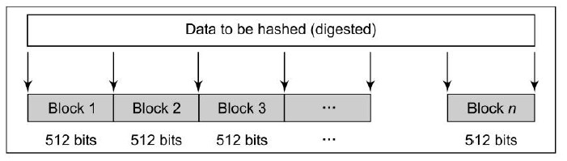

Slide 13
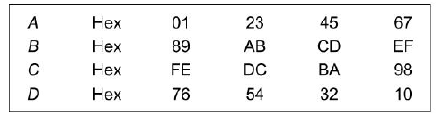
Step 4: Initialize Chaining Variables
Now, four chaining variables, a through d, are initialized. They are called A, B, C and D. Each of these is a 32-bit number.
Notes:
Size of buffer =32 buts
32 *4=128 bits
A=01234567
B=89ABCDEF
C=FEDCBA98
D=76543210

Slide 14
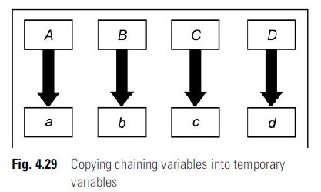
Step 5: Process Blocks
Step 5.1 Copy the chaining variables A-D into variables a-d. The combination of a-d, called abcd, will be considered as a single register for storing the temporary intermediate as well as the final results.

Slide 15
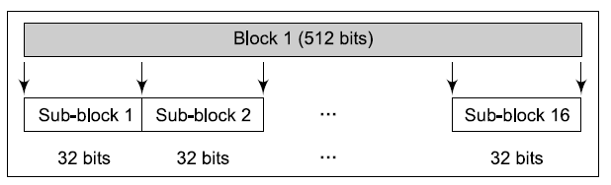
Step 5: Process Blocks
Step 5.2 Now, divide the current 512-bit block into 16 sub-blocks, each consisting of 32 bits.

Slide 16
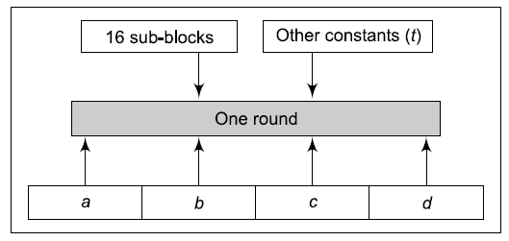
Step 5: Process Blocks
Step 5.3 Now, we have four rounds. In each round, we process all the 16 sub-blocks belonging to a block. The inputs to each round are (a) all the 16 sub-blocks, (b) the variables a, b, c, d, and (c) some constants, designated as t.
Notes:
32 * 16=512

Slide 17
Step 5: Process Blocks
In each round, we have 16 input sub-blocks, named M[0], M[1], …, M[15], or in general, M[i], where i varies from 1 to 15. As we know, each sub-block consists of 32 bits.
● Also, t is an array of constants. It contains 64 elements, with each element consisting of 32 bits. We denote the elements of this array t as t[1], t[2], … t[64], or in general as t[k], where k varies from 1 to 64. Since there are four rounds, we use 16 out of the 64 values of t in each round.
add modulo 2³²
M[i] – 32 bit message.
K[i] – 32-bit constant.
<<<n – Left shift by n bits.

Slide 18
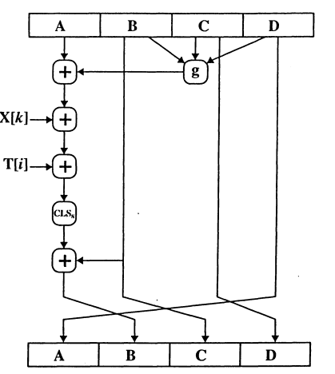
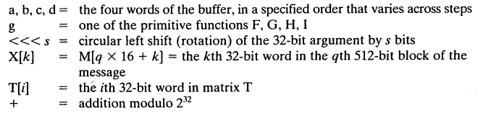
Step 5: Process Blocks

Slide 19
We can mathematically express a single MD5 operation as follows:
a = b + ((a + Process P (b, c, d) + M[i] + T[k]) <<< s)

Slide 20
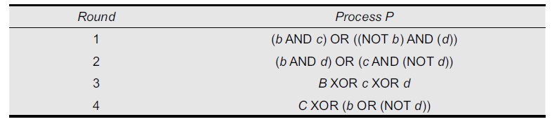
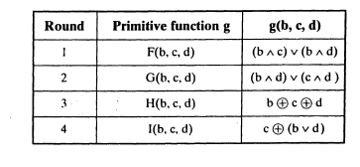

Slide 21
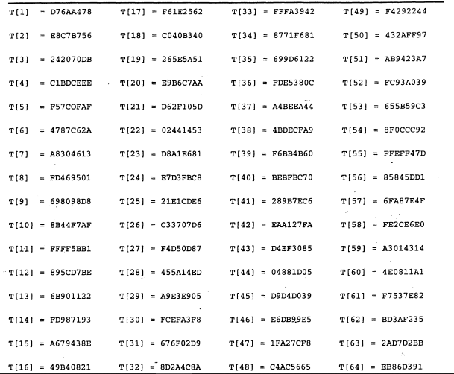
Table T constructed from the sine function

Slide 22
Example
Initialization Buffers:
A=67452301
B=EFCDAB89
C=98BADCFE
D=10325476
F=(B AND C) OR(NOT B AND D)
B= 1110 1111 1100 1101 1010 1011 1000 1001
C =1001 1000 1011 1010 1101 1100 1111 1110
---------------------------------------------------------------------
1000 1000 1000 1000 10001 1000 1000 1000
B̅ =0001 0000 0011 0010 0101 0100 0111 0110
D=0001 0000 0011 0010 0101 0100 0111 0110
-------------------------------------------------------------------
0001 0000 0011 0010 0101 0100 0111 0110
After OR
1001 1000 1011 1010 1101 1100 1111 1110

Slide 23
Example
Addition Module with A
1001 1000 1011 1010 1101 1100 1111 1110
A=0110 0111 0100 0101 0010 0011 0000 0001
--------------------------------------------------------------
1111 1111 1111 1111 1111 1111 1111 1111
--------------------------------------------------------------
Addition modulo with X[32]
In little endian order
80 63 62 61
1000 0000 0110 0011 0110 0010 0110 0001
1111 1111 1111 1111 1111 1111 1111 1111
--------------------------------------------------------------
1000 0000 0110 0011 0110 0010 0110 0000
Notes:
Little- least significant bits are put first

Slide 24
Example
T[1] = DT 6A A1 78
1000 0000 0110 0011 0110 0010 0110 0000
T= 1101 0111 0110 1010 1010 0100 0111 1000
= 0101 0111 1100 1100 0000 0110 1101 1000
-----------------------------------------------------------------
Circular left shift of 7 bits for the 1st step of Round1
1110 0110 0000 0011 0110 1100 0010 1011
Addition modulo with B=EFCDAB89
1110 1111 1100 1101 1010 1011 1000 1001
-----------------------------------------------------------------
1101 0110 1101 0001 0001 0111 1011 0100
----------------------------------------------------------------
D6D11784 ➔A
Notes:
Little- least significant bits are put first

Slide 25
MD5 vs. MD4
A fourth round has been added.
Each step has a unique additive constant.
The function g in round 2 was changed from (XY v XZ v YZ) to (XZ v Y not(Z)).
Each step adds in the result of the previous step.
The order in which input words are accessed in rounds 2 and 3 is changed.
The shift amounts in each round have been optimized. The shifts in different rounds are distinct.

Slide 26
MD5 vs. MD4
A fourth round has been added.
Each step has a unique additive constant.
The function g in round 2 was changed from (XY v XZ v YZ) to (XZ v Y not(Z)).
Each step adds in the result of the previous step.
The order in which input words are accessed in rounds 2 and 3 is changed.
The shift amounts in each round have been optimized. The shifts in different rounds are distinct.

Slide 27
Applications of MD5 Algorithm
MD5 is used as a checksum to verify the integrity of files and data by comparing the hash of the original file with the file received to check if the files or data has been altered.
MD5 is used for data security and encryption e.g. Secure password of users in database and non-sensitive data.
It is used in version control systems to manage different versions of files.
It was earlier used in digital signatures and certificate but due it’s vulnerabilities, it has been replaced by more secure algorithms like SHA-256.

Slide 28
Try….
In MD5, M= VIT VELLORE; Show the initial message blocks, padding bits and length field.
Find the logic functions F,G, H and I only. The buffer values are given:
Word A: 10 32 54 76 Word B: ba fe cd 98 Word C: 78 ce ae de Word D: 01 23 45 67

Slide 29
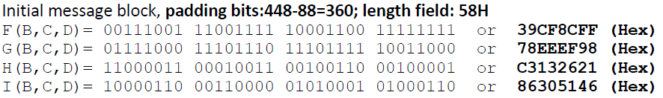
Try….(Contd…)
Solution:

